Slide 1
Regression Metrics
MACHINE LEARNING EXPERT

Slide 2
Regression Metrics
Regression metrics are used to evaluate the performance of regression models, which predict continuous numeric values.
Types of Regression Metrics
Mean Squared Error (MSE)
Root Mean Squared Error (RMSE)
Mean Absolute Error (MAE)
R-squared (R²) Score
Adjusted R2 Score
MACHINE LEARNING EXPERT

Slide 3
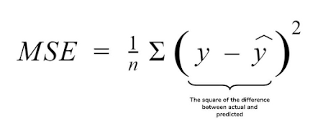
Mean Squared Error (MSE)
Actual value Predicted values
Mean Squared Error is a most used and very simple.
Mean Squared Error states that finding the squared difference between actual and predicted value.
MACHINE LEARNING EXPERT

Slide 4
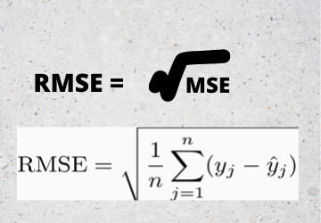
Root Mean Squared Error
RMSE is clear by the name itself, that it is a simple square root of mean squared error.
MACHINE LEARNING EXPERT

Slide 5
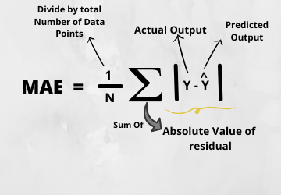
Mean Absolute Error (MAE)
Mean Absolute Error is a very simple metric which calculates the absolute difference between actual and predicted values.
MACHINE LEARNING EXPERT

Slide 6
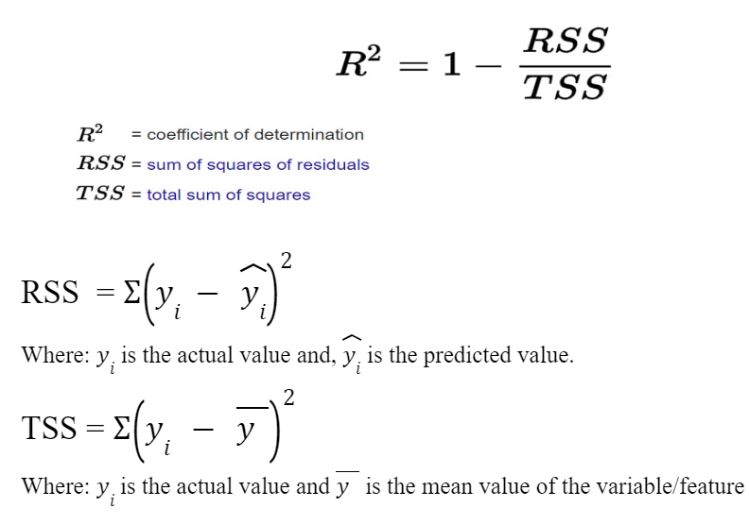
R-squared (R²) Score
R2 Score tells about model Goodness of the fit
R2 Score tell us how much data information we get about target variable and how much data has been fit by our model.
MACHINE LEARNING EXPERT

Slide 7
Adjusted R2 Score
Adjusted R2 Score penalize the attributes or Features that are not co-related with target variables.
_Formula_
Adjusted R-Squared = 1- [(1 – R²) (n – 1)/ (n – k – 1)]
where,
n: number of data points
k: number of independent variables
R: R-squared value
MACHINE LEARNING EXPERT

Slide 8
Questions?
Q&A Session
MACHINE LEARNING EXPERT

